Slide 1
From One-to-Many to Many-to-Many:
Traditional and New Media
Chapter Ten

Slide 2
Chapter Objectives
Understand the communication process and the traditional promotion mix
Understand how marketers communicate using an updated communication model that incorporates buzz marketing activities and new social media
Describe the steps in traditional and multichannel promotional planning
Copyright © 2013 Pearson Canada Inc.
10-<number>
Notes:
p. 356
LECTURE NOTES:
After finishing this chapter, you should:
Understand the communication process and the traditional promotion mix
Understand how marketers communicate using an updated communication model that incorporates buzz marketing activities and new social media
Describe the steps in traditional and multichannel promotional planning

Slide 3
I. Understand the communication process and the traditional promotion mix
Copyright © 2013 Pearson Canada Inc.
10-<number>
Notes:
This slide relates to Learning Objective (hereafter LO) #1 of chapter 10.

Slide 4
One-to-Many: The Traditional Communication Model
Promotion
    The coordination of a marketer’s communication efforts to influence attitudes or behaviour
Marketing communications purpose
  Inform
  Remind
  Persuade
  Build relationships
Copyright © 2013 Pearson Canada Inc.
10-<number>
Notes:
This slide relates to LO #1 of chapter 10.
p. 356
LECTURE NOTES:
Promotions is one of the four “P”’s of the marketing mix, and plays the most vital role in coordinating, creating, and delivering various forms of marketing communications. Marketing communications include not just the typical forms of advertising such as TV, radio, and magazine, but also sales promotions, personal selling, and brand-related publicity and sponsorship marketing.
It’s also important to recognize that other elements of the marketing mix communicate something about the product – the package design, the employee uniforms, even the price, as we learned in the previous chapter.
Thus the communication potential of all marketing decisions need to be considered for consistency and viability prior to implementation.
Different marketing communications are used to accomplish different things. Perhaps the easiest way to summarize the purpose of marketing communications is to review the four key purposes is can be used to accomplish:
Inform consumers about new or improved goods or services
Remind consumers about brands, in order to encourage their continued usage
Persuade consumers to choose one brand over the others
Build relationships with customers that encourage brand loyalty and long-term patronage.

Slide 5
One-to-Many: The Traditional Communication Model (ctn’d)
Integrated marketing communication (IMC)
    A strategic business process that marketers use to plan, develop, execute, and evaluate coordinated, measurable, persuasive brand communication programs over time to targeted audiences
Multichannel promotional strategy
    A marketing communication strategy where they combine traditional advertising, sales promotion, and public relations activities with online buzz-building activities
Copyright © 2013 Pearson Canada Inc.
10-<number>
Notes:
This slide relates to LO #1 of chapter 10.
p. 357
LECTURE NOTES:
The best promotional strategies are those that blend several diverse forms of marketing communications, as well as different types of each form. For example, consumers may first learn about a brand via an article in the newspaper stemming from a news release, then see an ad on TV, and then sample the brand at the store. IMC recognizes that consumers learn about brands via different methods and contacts, or touchpoints as they are often called. Promotional plans that actively seek to establish a multitude of contact methods and touchpoints are called integrated marketing communications, or IMC.
With IMC, marketers unify all marketing communication tools to send a consistent, persuasive message using a multichannel promotional strategy. A multichannel strategy combines advertising, sales promotions, publicity, online buzz building activities and many other potential methods, as are appropriate for the product or service in question.
The goal of integrated marketing communication strategies is to surround the customer with the firm’s message. Sometimes this mean using very, very specific media to reach a portion of the overall target market. Beach’n Billboard is one of many new firms that offer marketers unique ways of reaching their customers.

Slide 6
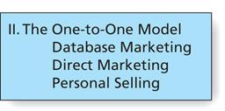
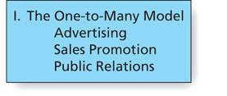
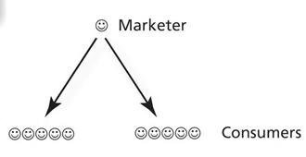
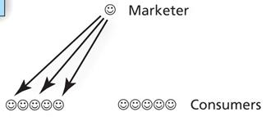
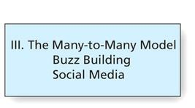
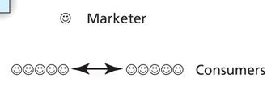
Figure 10.1
Three Models of Marketing Communication
Copyright © 2013 Pearson Canada Inc.
10-<number>
Notes:
This slide relates to LO #1 of chapter 10.
p. 358
LECTURE NOTES:
Figure 10.1 illustrates three different communication models which attempt to explain how consumers acquire information.
The one-to-many model relies on traditional forms of mass communication, such as TV, radio, magazine, and newspaper advertising, billboards and other out-of-home advertising, and Internet advertising to reach literally millions of people. Sales promotions such as coupons, samples, rebates and more are also part of this model, as are event and sponsorship marketing, and brand-related publicity efforts.
By contrast, the many-to-many model of communication recognizes the need to update communication methods to account for changes in our now “wired” world. Social network marketing and word-of-mouth communication are incorporated into this model of communication. Viral marketing, evangelical marketing, and product review sites also play a role in the many-to-many model.
The one-to-one model expands upon the traditional model by recognizing the importance and contributions of personal selling, direct marketing, and database marketing.

Slide 7
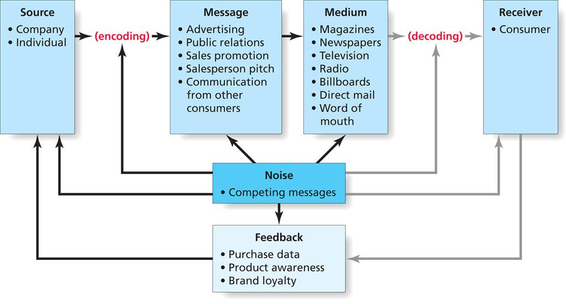
Figure 10.2
Communications Model
10-<number>
Notes:
This slide relates to LO #1 of chapter 10.
p. 359
LECTURE NOTES:
The communication model explains how organizations create and transmit messages. There are several elements to the model:
SOURCE: Is the firm or person sending a message. Within a marketing communication execution, the source could also be considered to be the person who is delivering the information, such as the sales representative, actor, celebrity endorser, or actual consumer.
ENCODING: Refers to the transmission of an idea into a form of communication that conveys meaning to the receiver.
MESSAGE: The message is simply the physical form of the communication that goes from a sender to a receiver. Messages may contain both verbal (ad copy, script that is read) and nonverbal elements (visual scenery, etc.).
MEDIUM: Television, radio, salespeople, an Internet blog are just some examples of the various media that marketers can use to transmit the message. Choosing the medium is important as marketers must make certain that the target market is exposed to the medium, and that the attributes or benefits of the advertised product or service are compatible with the medium.
RECEIVERS: are the target of the communication. They may be consumers, other businesses, or news outlets, to name just a few. Assuming that the receiver has paid attention to the message, to successfully decode the message, the receiver and source must share a mutual frame of reference, otherwise miscommunication occurs.
If receivers are to be able to successfully DECODE the message, the words/images/etc. chosen to form the message must be capable of communicating the shared meaning. This ensures that the message as encoded is properly interpreted when decoded by the receiver. Cultural, geographic, and educational differences among receivers can influence the extent to which the message meaning is shared, and thus is properly decoded. The receiver will interpret the message in light of his or her unique experiences.
NOISE is simply anything that interferes with the transmission or decoding of the message. Noise may LITERALLY be noise, such as when a hungry infant screams for her bottle, distracting her mother’s attention from the TV and the advertisement being shown. Noise may also occur when the satellite feed breaks down due to heavy cloud cover, or take the form of clutter – competing marketing communications that vie for the consumers attention. Noise can actually occur at ANY stage in the communication process. Marketers try to minimize noise when they place messages in media where there is less likely to be distractions or alternative messages from the competition.
FEEDBACK from the receiver to the source is a desirable outcome of the communication process. Some feedback is indirect and tracked via measures related to the goals of the marketing communications campaign (e.g., coupon redemptions, contest entries). Other types of feedback are more direct (phone calls, email messages, survey completions, product registrations, etc.) If consumers are unhappy, they may eagerly provide feedback. Marketers should be certain to encourage feedback by offering toll-free phone numbers or email addresses where consumers can voice their concerns or praise.

Slide 8
The Communications Model
The source encodes
Source
    An organization or individual that sends a message
Encoding
    The process by which a source translate an idea into a form of communication that conveys the desired meaning
Copyright © 2013 Pearson Canada Inc.
10-<number>
Notes:
This slide relates to LO #1 of chapter 10.
p. 359

Slide 9
The Communications Model (ctn’d)
Message
    The communication in physical form that goes from a sender to a receiver
Medium
    A communication vehicle through which a message is transmitted to a target audience
    Can be television, radio, social media sites, magazine, web site, a blog, personal contact, billboard…
Copyright © 2013 Pearson Canada Inc.
10-<number>
Notes:
This slide relates to LO #1 of chapter 10.
p. 359 – 360

Slide 10
The Communications Model (ctn’d)
The receiver decodes
Receiver
    The organization or individual that intercepts and interprets the message
Decoding
    The process by which a receiver assigns meaning to the message
Copyright © 2013 Pearson Canada Inc.
10-<number>
Notes:
This slide relates to LO #1 of chapter 10.
p. 360

Slide 11
The Communications Model (ctn’d)
Marketers need to minimize noise that can block message
    Noise: anything that interferes with effective communication
The source try to get feedback from receivers to gauge the effectiveness of the message
    Feedback: receivers’ reactions to the message
Copyright © 2013 Pearson Canada Inc.
10-<number>
Notes:
This slide relates to LO #1 of chapter 10.
p. 360 - 361

Slide 12
BAB235 CH 10 - IN-CLASS ACTIVITY
As you were going through your day you were exposed to many forms of marketing communication. However, noise probably interfered with most of the exposures.
List five different instances where noise interrupted your ability to decode a message.
Explain what, if anything, a marketer could have done to help limit some of the noise.
Copyright © 2013 Pearson Canada Inc.
12-<number>

Slide 13
The Traditional Promotion Mix
Promotion mix
    Communication elements that the marketer controls. These elements include
      Advertising
      Sales promotion
      Public relations
      Personal selling
      Direct marketing
Copyright © 2013 Pearson Canada Inc.
10-<number>
Notes:
This slide relates to LO #1 of chapter 10.
p. 361

Slide 14
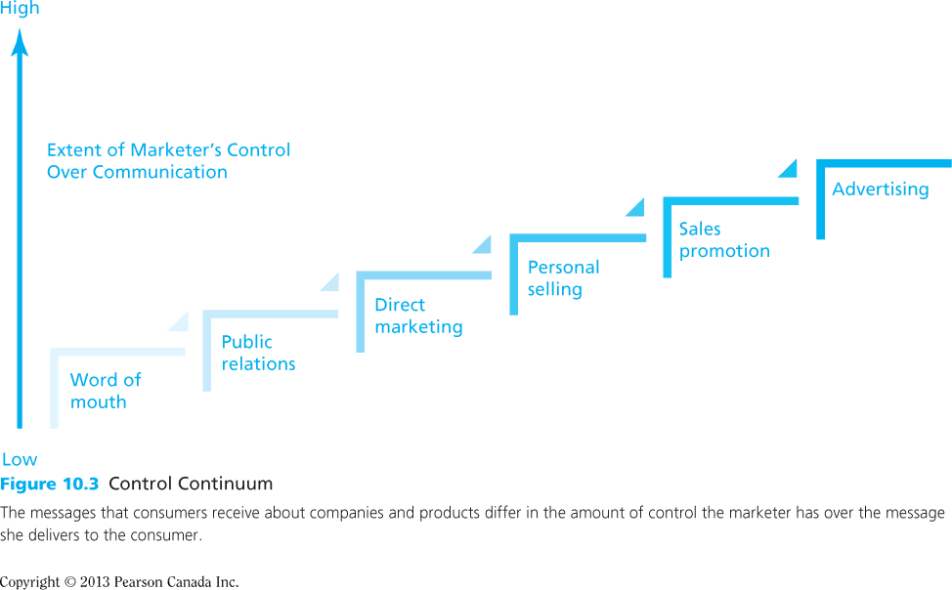
Figure 10.3
Control Continuum
Copyright © 2013 Pearson Canada Inc.
10-<number>
Notes:
This slide relates to LO #1 of chapter 10.
p. 362
LECTURE NOTES:
Figure 10.3 illustrates the extent of control that marketer’s have over the various forms of communication that comprise the promotional mix.
It’s also interesting to note that very often marketers face a trade-off between the extent of message control and the perceived credibility of the message. The more control marketer’s have over message form and content, the less likely consumers may be to believe the message (all else being equal).
Another consideration in the promotion mix relates to the extent to which elements in the promotion mix are stressed. This depends in part upon the nature of the product. For example, advertising and consumer-oriented sales promotions are key tools for building consumer demand for packaged goods, whereas communication efforts undertaken by the sales force are often key to generating business-to-business sales.

Slide 15
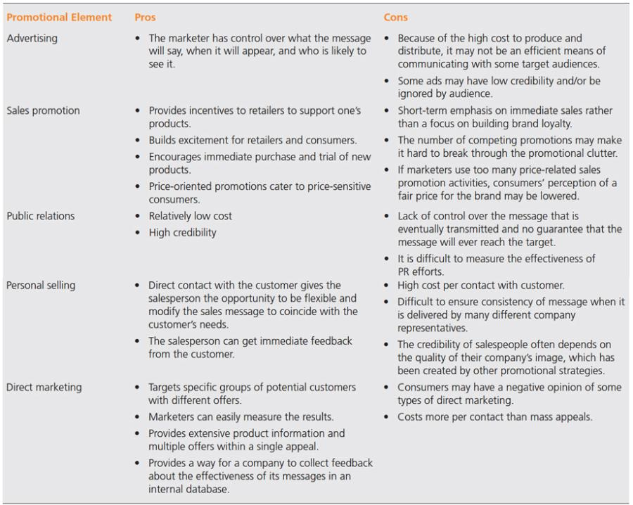
Table 10.1
A Comparison of Elements of the Traditional Promotional Mix
Copyright © 2013 Pearson Canada Inc.
10-<number>
Notes:
This slide relates to LO #1 of chapter 10.
p. 363
LECTURE NOTES:
Table 10.1 presents a comparison of the pros and cons associated with each element of the traditional promotional mix. It provides a nice summary of information that we will be discussing as we continue through the chapter.
Certain elements of the promotion mix are intended for a large number of people, and as such, use mass communication channels such as TV, magazines, newspapers, radio, or newspapers. Advertising, sales promotion, and public relations make use of mass communication.
On the other hand, personal selling and direct marketing are forms of personal communication that allow marketers to communicate one-on-one.
We will discuss each of these elements in more detail on the following slides.

Slide 16
Mass Communications
Mass communications are intended to reach many prospective customers at the same time
Advertising
    Nonpersonal communication from an identified sponsor using mass media
Sales promotion
    Contests, coupons, and other incentives designed to build interest or encourage product purchase during a specified period
Public relations
    Communication activities that create or maintain a positive image of a firm and its products
Copyright © 2013 Pearson Canada Inc.
10-<number>
Notes:
This slide relates to LO #1 of chapter 10.
p. 361 - 362
LECTURE NOTES:
Advertising is defined as any nonpersonal communication from an identified sponsor using mass media. It’s certainly the most familiar and visible element of the promotional mix, and as previously noted, provides marketers with total control over the message.
Additional advantages include the fact that rich and dynamic advertising images can help to build or reinforce brand image. Advertising also serves the purpose of informing consumers by providing factual information, as well as a reminder function.
Unfortunately, advertising does have its drawbacks. Specifically, advertising is extremely expensive to produce and distribute. Super Bowl ads cost over 3 million dollars for a single 30 second spot; regular prime-time ads distributed nationally can cost in the hundreds of thousands of dollars.
Furthermore, some ads lack credibility with cynical consumers and many consumers simply ignore ads, a feat made all the easier by technology such as DVD recorders.
Sales promotions are short-term incentives that are offered in an attempt to make the target of the offer act quickly; their goal is to motivate behavior, or action on the part of the consumer.
Aside from the consumer-oriented sales promotions activities that students encounter everyday, sales promotions include activities that target middlemen. These trade-oriented sales promotion techniques include various forms of allowances (slotting allowances, advertising allowances, display allowances, buying allowances), trade shows, co-op advertising opportunities, and several other tactics.
Sales promotions offer a number of advantages. The trade promotions mentioned earlier provide retailers with incentives to support a brand at the store level, and encourages retailer promotions to consumers.
Sales promotions such as contests, sweepstakes, and games can also build retailer and consumer excitement.
A strong advantage, especially in the marketing of new products, is that sales promotions such as sampling and certain forms of coupons can encourages immediate purchase and trial.
Many forms of sales promotions are very effective at reaching the price-sensitive consumer, and as such can be helpful in retaining customers and generating revenue when the economy is doing poorly.
Drawbacks include the fact that sales promotion do not focus on building brand loyalty; in fact, research has shown that many consumers who a brand on “deal” (e.g., when some type of incentive is available), return to the brand bought previously once the promoted brand goes off deal.
Finally, the sheer amount of couponing and other forms of promotion create a clutter that is often hard to break through.
Public relations activities primarily are used to create or maintain a positive image for the firm. One subset of public relations, publicity, is often brand specific and can be very helpful in creating awareness for new brands.
Two key advantages of publicity include its low cost and high credibility. News releases often generate a large amount of publicity – costs are limited to the salary of the publicist and the costs associated with distributing news releases and tracking their effectiveness. There are no media costs for publicity – any air time or space devoted in the newspaper to the subject of a news release is given by the media free-of-charge.
Compared to advertising and other forms of marketing communications, publicity is more perceived by consumers as being more credible. This is because the media is perceived as being an objective intermediary that has nothing to gain or lose by endorsing (or slamming) a product on which they may have received a news release.
Unfortunately, there are also disadvantages associated with publicity and public relations. Specifically, the marketer has no control over the message once a news release or other publicity communication leaves their office. The media can take the most positively spun news release and write a very negative article. There is also no guarantee that message will even reach the target market.
It is also difficult to track the effectiveness of results.

Slide 17
Personal Communications
Personal communications are intended to communicate with consumers on a personal, one-on-one level
Personal selling
    Direct interaction between a company representative and a customer
Direct marketing
    Efforts to gain a direct response from individual consumers
Copyright © 2013 Pearson Canada Inc.
10-<number>
Notes:
This slide relates to LO #1 of chapter 10.
p. 362 - 363
LECTURE NOTES:
Personal selling is one form of personal communication, with direct marketing being the other.
The majority of personal selling takes place in the business-to-business arena between representatives of manufacturers and either wholesalers, retailers, or end users of their products. However, some personal selling does occur in the B2C context. These interaction can range from the “Can I take your order?” types of transactional selling interaction to more involved sales interactions between consumers and car dealer representatives, for examples.
The key advantages of personal selling include the fact that it is flexible, which means that salespeople can modify the message to match customer needs. Another very important advantage is that personal selling involves two-way communication, which means that the sales representative receives immediate feedback from the buyer, allowing him or her to answer questions, counter objections, or clarify information.
Less positive are the facts that fielding a sales force can be expensive in that the cost per contact can be very high. If is also difficult to ensure message consistency between different salespeople, and the credibility of the salesperson to a large extent is linked to the image of the firm.
Marketers also use direct mail, telemarketing, and other direct marketing efforts to create personal appeals.
Direct marketing allows marketers to easily target specific customers with different offers that cater to their needs. It is also easy to measure the results of direct marketing efforts. Unlike TV or radio advertising, direct marketing can be used to provide extensive information and multiple offers with a single appeal. Furthermore, direct marketing facilitates information collection via databases.
The key drawbacks of direct marketing include the fact that many consumers dislike direct marketing and often direct marketing costs are higher on a per contact basis than mass appeals.

Slide 18
II. Understand how marketers communicate using an updated communication model that incorporates buzz marketing activities and new social media
Copyright © 2013 Pearson Canada Inc.
10-<number>
Notes:
This slide relates to LO #2 of chapter 10.

Slide 19
Many-to-Many: The New Media Communication Model
Groundswell
  A social trend in which people use technology to get the things they need from each other, rather than from traditional institutions such as corporations
The many-to-many communication model relies on consumers talking to one another
The key is to create buzz building activities
Copyright © 2013 Pearson Canada Inc.
10-<number>
Notes:
This slide relates to LO #2 of chapter 10.
p. 364
LECTURE NOTES:
The changing communication landscape has been referred to as groundswell. Groundswell accounts for the fact that many consumers are getting their information from one another rather than from the original source.
The many-to-many communication model works today because the Internet has enabled many new forms of communication, such as via email, Facebook, blogs, and via other mechanisms. At the same time, traditional advertising is diminishing in its effectiveness as a method of talking with customers. As more companies venture into social network marketing and online advertising, increased budgets in these areas have come at the expense of more traditional media.
Of course Internet consumers are also harder to please as they have access to more information that allow for meaningful price and product comparisons, as well as the ability to buy items at prices below retail via online auction sites.
A key consequence stemming from the groundswell is that to be successful, marketers must view buzz building activities as key. We’ll talk more about this concept on the coming slides.

Slide 20
Buzz Building
Buzz
    Word-of-mouth communication that customers view as authentic
Buzz activities have many names, e.g.
    Word-of-mouth marketing, viral marketing, buzz marketing, evangelist marketing
Technology has magnified the importance of buzz
Copyright © 2013 Pearson Canada Inc.
10-<number>
Notes:
This slide relates to LO #2 of chapter 10.
p. 365
LECTURE NOTES:
The many-to-many model of communication relies on consumers talking to each other about goods, services, or organizations.
Many firms spends millions of dollars trying to create positive buzz for the products or services using a variety of techniques, including word-of-mouth marketing, viral marketing, buzz marketing, and evangelist marketing.
While word-of-mouth has been around for quite a long time, technology has magnified its importance, making a given consumer’s blog or product review available instantaneously to millions world wide. Since the credibility of word-of-mouth communication is perceived as being much higher than advertising, marketers are right to be concerned with efforts that can stimulate positive buzz for their brands. The Word-of-mouth-marketing association labels such efforts as “amplified buzz”.
Of course not all buzz can be controlled – organic WOM – which occurs naturally, often results from consumer complaints as Southwest Airlines learned when a patron was removed from the plane because he was too fat to fit in his seat. The customer used Twitter to share the word with others, and Southwest was forced to backtrack by apologizing to the individual in question and offering him a seat on the plane.

Slide 21
Ethical Problems in Buzz Marketing
Activities designed to deceive consumers
Directing buzz marketing at children or teens
Buzz marketing activities that damage property
Stealth marketing activities that deliberately deceive or lie on behalf of clients
Copyright © 2013 Pearson Canada Inc.
10-<number>
Notes:
This slide relates to LO #2 of chapter 10.
p. 366
LECTURE NOTES:
Unfortunately, buzz marketing also creates opportunities for unethical or questionable marketing behavior.
These include activities designed to deceive consumers, such as Shilling, which means paying people to talk about or promote a product without disclosing the fact that they are working for a firm is also considered unethical.
Directing buzz activities towards children or teens has also come under scrutiny for the same reason that advertising towards children is regulated. This is because children are seen as being more impressionable and thus easier to deceive than adults.
Of course any buzz marketing activities that damage property are unethical. Vandalism can occur as a result of campaigns such as Puma, which encouraged consumers to encourage their cat logo all over Paris.
Of course any stealth marketing activities that deliberately lie or deceive on behalf of a client are unethical. An example would be infiltration, in which fake identities are created in online discussion boards or blogs and used to promote a product or for some other purpose. Falsification is also a problem, and refers to severe ethical lapses in which a marketer knowingly disseminates false or misleading information. They can also be as mundane as pretending to read a new novel on the bus.
Table 12.2 summarizes the positive and unethical word-of-mouth marketing strategies.
In addition to several techniques already discussed, Comment Spam, which uses automated software bots to post unrelated or inappropriate comments to blogs or other online communities is considered to be unethical, in addition to traditional Spam (bulk emailing to individuals without their permission).

Slide 22
Viral Marketing
Viral marketing is one form of buzz building
Viral marketing
    Marketing activities that aim to increase brand awareness or sales by consumers passing a message along to other consumers
    Consists of use of video clips, interactive games, or other interesting activities that consumers will share with their friends using digital technology
    http://www.marketingterms.com/how-to-do-viral-marketing/
Copyright © 2013 Pearson Canada Inc.
10-<number>
Notes:
This slide relates to LO #2 of chapter 10.
p. 366 - 367
LECTURE NOTES:
One form of buzz building occurs via viral marketing. Viral marketing tactics often feature interactive games, video clips or other activities that consumers will find interesting, funny, or unique enough to share with others.
A classic example of a successful viral campaign is Burger King’s subservient chicken.com website, which was created to promote the BK Tendercrisps nuggets.

Slide 23
Brand Ambassadors and Evangelists
Brand ambassadors and evangelists
    Loyal customers of a brand recruited to communicate and be salespeople with other consumers for a brand they care a great deal about
Copyright © 2013 Pearson Canada Inc.
10-<number>
Notes:
This slide relates to LO #2 of chapter 10.
p. 367 - 368
LECTURE NOTES:
Loyal customers are frequently recruited to serve as brand ambassadors or evangelists. While they often work for free, more and more expect to be paid for their services. True brand ambassadors should be loyal, even zealous consumers of the brand who use it frequently and want it exceed. Macintosh, the iPhone, and the iPad are all known for having strong brand ambassadors and evangelists who constantly tell others about how they love their Apple product.
Brand evangelists are often recruited from among those who blog in positive fashion about the product. Providing special access or other privileges may motivate consumers to serve as brand ambassadors.

Slide 24
Class Discussion
Many companies are using brand ambassadors or brand evangelists to spread the word about their product.
For what types of products do you think brand ambassadors are likely to be most useful?
When would they be less useful?
Would you be willing to be a brand ambassador for a product? If so, which product(s)? If not, why not?
Copyright © 2013 Pearson Canada Inc.
12-<number>

Slide 25
New Social Media
Social media
    Internet-based platforms that allow users to create their own content and share it with others who access these sites
    An important part of the updated communication model
    Include blogs, forums, picture- and video-sharing sites, wikis, podcasts, social network cites, virtual worlds, product review sites, geospatial mobile apps
Copyright © 2013 Pearson Canada Inc.
10-<number>
Notes:
This slide relates to LO #2 of chapter 10.
p. 368
LECTURE NOTES:
Social media gives consumers the opportunity to easily spread the word about product experiences. While this makes it easier for firms to tap into their brand evangelists, it also means that negative information spreads more quickly when consumers have a problem or poor experience with a product or service.
Social media includes blogs, forums, photo and video-sharing sites, wikis, podcasts, and of course social network sites such as Twitter and Facebook.

Slide 26
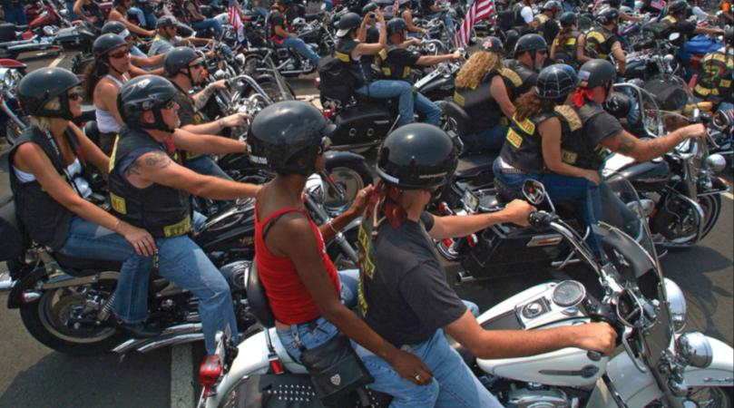
Social Networks
Social networking sites connect people with similar people based on profiles
Key social networking sites
  Facebook
  Twitter
  LinkedIn
What brands
do you like
or follow?
Copyright © 2013 Pearson Canada Inc.
10-<number>
Notes:
This slide relates to LO #2 of chapter 10.
p. 368 - 369
LECTURE NOTES:
Most of you are familiar with social network sites such as FaceBook and LinkedIn. From a marketing standpoint, social networks facilitate marketers’ ability to reach and influence journalists and public opinion leaders.
Another opportunity that social networks provide is the ability to create a brand community. Brand communities are groups of people who organize around a lifestyle or idea that is representative of the brand. The feel connected to the brand and share the rituals and traditions associated with it. For example, Harley Davidson’s H.O.G.s, the Harley Owners Group, is an example of a brand community that sponsors huge rallies around the country where members can meet up. Of course these events attract attention of non-Harley owners, and offer them the opportunity to speak with real Harley users who in turn can act as brand ambassadors.
Facebook is the most popular social networking site, and as such allows marketers to establish Facebook groups around topics that allow them to recruit fans for their product.
Twitter, on the other hand, is a free microblogging service that lets users post short text messages with a maximum of 140 characters. Users can follow anyone they like, and it has been estimated that 20% of the tweets posted feature a comment or question about a product.
Many firms are now using Twitter as an informal source of marketing research information about their brand, while others use Twitter to tell followers about exclusive deals or sales.
DISCUSSION NOTES:
Asking students what brands they “like” on Facebook, and which they follow on Twitter, as well as why the do so, could provide some excellent examples of current social network marketing campaigns.

Slide 27
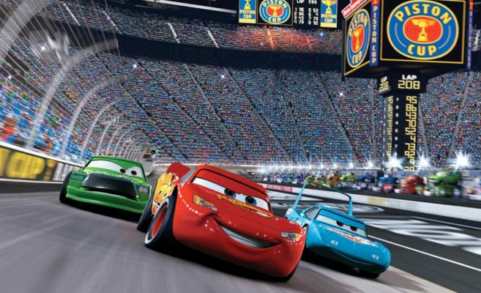

Virtual Worlds
Virtual worlds
    Online, highly engaging digital environments where avatars live and interact with other avatars in real time
  Avatars
  Virtual goods
Second Life
World of Cars
Copyright © 2013 Pearson Canada Inc.
10-<number>
Notes:
This slide relates to LO #2 of chapter 10.
p. 369 - 372
LECTURE NOTES:
Virtual worlds are described in the textbook as highly engaging digital environments where avatars live and interact with avatars in real time.
Some marketers, such as Coca-Cola and Disney, have created promotional virtual worlds for their products. For example, Disney’s Toontown offers kids a brightly colored cartoon environment where they can play games for free. Additional content can be accessed by members, and avatar outfits are examples of virtual goods that can be purchased on the site. In preparation for the launching of the Cars 2 movie, Disney launched an online community called the World of Cars.
Thus virtual worlds are not only useful for building brand relationships and improving brand images, they also serve as revenue streams and marketplaces. Most items sold via virtual worlds are priced in the “micro” range, meaning that they cost between $1 and $3 to purchase.
WEBSITE NOTES:
Of the three virtual worlds shown, it might be most beneficial to visit the Second Life site, then click on the “What is Second Life” link. This will launch the INTRO video that shows different aspect of the second life virtual world.

Slide 28
Product review sites
Product review sites
    Social media sites that enable people to post stories about their experiences with products and services
  Marketers seek to create a connection between consumers and the brand
  Both positive and negative information is available
Angie’s List
Copyright © 2013 Pearson Canada Inc.
10-<number>
Notes:
This slide relates to LO #2 of chapter 10.
p. 372
LECTURE NOTES:
If you’re like many consumers today, you make use of product review sites when researching purchases that you plan to make either on- or off-line. What are some of your favorite product review websites?
Some of you may use specialized review sites, such as TripAdvisor or Cnet.com that specialize in reviews related to products within a given industry. Cnet.com reviews a variety of electronic products, while TripAdvisor provides hotel reviews, photos, and travel advice.
Consumer generated review sites are also growing; perhaps you have used the Epinion.com website.
Angie’s List offers consumer reviews of local contractors, landscapers, roofers, doctors, dentists, and other businesses that are submitted by verified members rather than anonymous contributors. They also allow company’s to respond to consumers reports.
Marketers hope that product review sites will create a connection between the consumer and the brand, though they also must be prepared for the fact that positive and negative reviews may be posted.

Slide 29
Mobile Apps and Geospatial Platforms
Smart phones and computer/phone hybrids, together with mobile apps, are the future of marketing communications
Geospatial platforms
    Digital applications that integrate sophisticated GPS technology to enable users to alert friends of their exact whereabouts via their mobile phones
Copyright © 2013 Pearson Canada Inc.
10-<number>
Notes:
This slide relates to LO #2 of chapter 10.
p. 372 – 373
LECTURE NOTES:
Smart phones and computer/phone hybrids like Apple’s iPad are the future of marketing communications. Ringtones, apps, and more produce revenue for many firms. But beyond the obvious, mobile apps are increasingly allowing marketers to reach consumers while they are on the go. For example, ShopSavvy finds coupons for brick-and-mortar stores, as well as the lowest prices around town, and also allows consumers to make transactions.
Geospatial platforms integrate GPS technology with mobile phones. These platforms allow users to tell their friends exactly where they are via a “check-in” process. Many marketers are finding that the use of check-in sites such as Foursquare and Shopkick can be used to increase sales when they offer discounts or free services to consumers who check in from the marketer’s place of business (e.g., the local Barnes and Noble store).

Slide 30
III. Describe the steps in traditional and multichannel promotional planning
Copyright © 2013 Pearson Canada Inc.
10-<number>
Notes:
This slide relates to LO #3 of chapter 10.

Slide 31
Promotional Planning in a Web 2.0 World
Step 1: Identify the target audience(s)
Step 2: Establish the communication objectives
Step 3: Determine and allocate the marketing communication budget
Step 4: Design the promotion mix
Step 5: Evaluate the effectiveness of the communication program
Copyright © 2013 Pearson Canada Inc.
10-<number>
Notes:
This slide relates to LO #3 of chapter 10.
p. 373 - 380

Slide 32
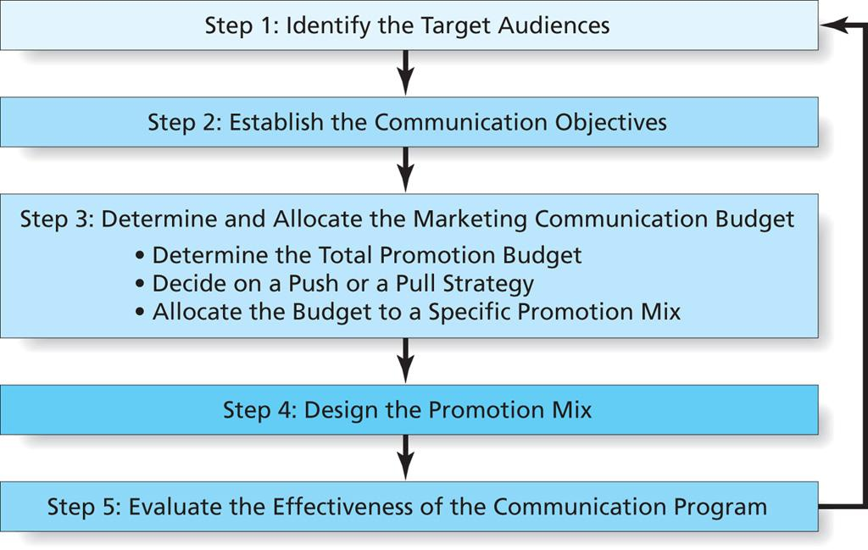
Figure 10.4
Steps in Developing the Promotional Plan
Copyright © 2013 Pearson Canada Inc.
10-<number>
Notes:
This slide relates to LO #3 of chapter 10.
p. 373
LECTURE NOTES:
Figure 10.4 shows the five key steps in developing a promotional plan.
The first step involves identifying the target audience. While the ultimate consumer is definitely one such target audience, it is often important to communicate with other stakeholders, including retailers, wholesalers, influencers (such as physicians who prescribe drugs), and community members.

Slide 33
Step 2: Establish the Communication Objectives
Communications objectives seek to move consumers through the hierarchy of effects, i.e., a series of steps from initial awareness of product to brand loyalty
Create awareness
Inform the market
Create desire
Encourage purchase and trial
Build loyalty
Copyright © 2013 Pearson Canada Inc.
10-<number>
Notes:
This slide relates to LO #3 of chapter 10.
p. 373 - 375

Slide 34
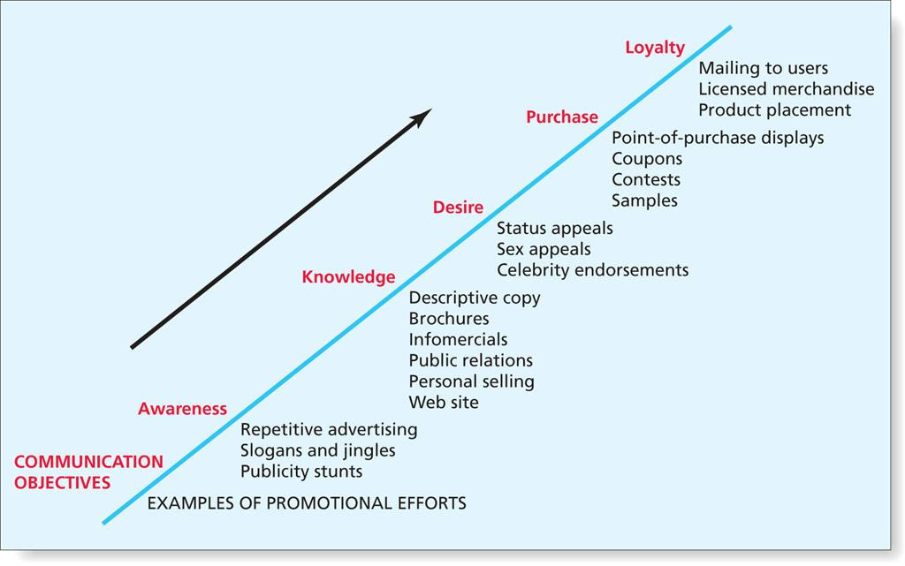
Figure 10.5
The Hierarchy of Effects
Copyright © 2013 Pearson Canada Inc.
10-<number>
Notes:
This slide relates to LO #3 of chapter 10.
p. 374
LECTURE NOTES:
Communication objectives seek to move consumers through the hierarchy of effects.

Slide 35
Step 3: Determine and Allocate the Marketing Communication Budget
Determine the total communications budget via one of the following
    Top-down budgeting
      Percentage-of-sales budgeting
      Competitive-parity budgeting
    Bottom-up budgeting
      Objective-task budgeting
Decide on a push strategy or a pull strategy
Allocate spending to specific promotion activities
Copyright © 2013 Pearson Canada Inc.
10-<number>
Notes:
This slide relates to LO #3 of chapter 10.
p. 375 - 376
LECTURE NOTES:
The third step in the promotional planning process requires that marketers make three distinct decisions. First and foremost, the overall communication budget must be determined. Next, the firm needs to decide whether to use a push or pull strategy. Finally, the budget must be allocated to specific promotional activities.
Most firms rely on either top-down or bottom-up budgeting techniques.
Top down techniques require that upper management take responsibility for establishing the budget. Many B2B and some consumer goods firms use the percentage of sales technique when creating their budgets. Simply put, a percentage is multiplied by the previous year’s sales, or forecast sales for the upcoming year to create the budget. While the percentage of sales method is used frequently and easy to compute, it reverses the relationship between sales and advertising by implying that sales causes promotional spending. Furthermore, this method doesn’t consider competitive factors or economic conditions. For example, suppose sales decline due to fierce competition and an economic recession. If the percentage is applied to past sales to determine the budget for the upcoming year, promotional spending will decrease at a time when an increase in spending is critical.
The competitive parity method benchmarks what competitors are spending and either attempts to keep pace with or outspend the promotional spending of a specific competitor. When a matching tactic is used, competitors typically maintain their market share from year to year, assuming that no new competitors enter the market. Furthermore, this method is flawed as it inherently suggests that each dollar spent by different firms will yield the same exact result.
Unlike these top-down techniques, bottom-up budgeting does not rely on established procedures and practices but instead attempts to build each year’s budget from scratch. This philosophy is at the heart of the objective-task method, in which the objectives defined by the marketer are analyzed, and the cost required to accomplish each is computed and summed to derive the final budget.
While the objective-task method is generally thought to the most logical and defensible form of budgeting, it is also the most time-consuming and difficult to accomplish. In fact, managers often find it impossible to truly “cost out” what accomplishing each objective will require in the way of investment, and instead rely on educated guesses.
When a firm follows a push strategy, it means that the company focuses its efforts on convincing channel members to carry and promote the product to the next member in the channel, or in the case of the retailer, to the ultimate consumer. This has implications for the how promotional dollars are allocated. For example, a push strategy would focus heavily on personal selling expenditures and trade promotions designed to incent the wholesalers and retailers to help distribute the product.
In the case of a pull strategy, the marketer focuses promotional efforts and spending more towards the ultimate consumers by means of heavy expenditures into advertising and consumer-oriented sales promotions. By creating awareness for and interest in the product, the marketer expects to “pull” the product through the channel as consumers request items be carried by the stores in which they shop.
Pharmaceutical drugs can be used to illustrate both strategies. Historically, prescription pharmaceutical drugs were marketed exclusively using a push strategy: the pharmaceutical firm hired sales representatives, who called on physicians in an attempt to educate them about the drug. Drug samples and other promotional items were left with the physician in the hope that the drug samples would be given to patients to try. Following a successful trial, physicians would prescribe the drug, which consumers would then purchase from a hospital or drug store pharmacy. No marketing communications efforts were directed at the consumer.
Nowadays though, it’s a bit different. Although pharmaceutical sales representatives still call on physicians, pharmaceutical firms now spend tremendous amounts of money in advertising directed at the consumer. Consumers who see an ad for a prescription drug can’t buy it on their own, but they can ask their doctor about the product and request that a prescription be written. In this sense, prescription drug advertising is used to help “pull” the product from the manufacturer, through the distribution channel.

Slide 36
GROUP IN-CLASS ACTIVITY
In groups think about how the pharmaceutical
industry might implement a push or a pull strategy.
What would each strategy “look” like?
How would the promotion mix differ using the two strategies?
Copyright © 2013 Pearson Canada Inc.
12-<number>

Slide 37
Step 4: Design the Promotion Mix
Involves determining the
    Specific promotional tools to use
    Message to be communicated
    Communication channel
  Ideally, the message should accomplish four communication goals
    Attention, interest, desire, and action (AIDA model)
Copyright © 2013 Pearson Canada Inc.
10-<number>
Notes:
This slide relates to LO #3 of chapter 10.
p. 378
LECTURE NOTES:
Designing the actual promotional mix is complicated, and requires that marketers determine how they can best use the various marketing communication tools, such as advertising and sales promotion, as well as the message to be communicated via each tool. Of course all marketing communication should be guided by the firm’s positioning statement. The message itself should be constructed to conform to the AIDA model, meaning that messages should achieve attention, interest, create desire, and ultimately lead to action.
More in-depth decisions are required when the communication channel and media strategy is considered. If advertising is to be used, what type? Newspaper? Internet? Television? Even more thought-provoking are decisions related to the specific media vehicles chosen to carry the message. For example, if magazine advertising is to be used, which specific magazine titles should be selected? Should the ads be full page or half page? Which months or weeks of the year should the ad appear? Designing the promotional mix and the media plan is a very complicated process. While the preceding discussion is superficial, it is simply meant to provide an overview.

Slide 38
Step 5: Evaluate the Effectiveness of the Communication Program
To decide whether the communication program is working
  Measurement involves tangibles and intangibles
    Sales volume
    Brand awareness
    Recall of product benefits
    Image of brand before and after the program
    …
Copyright © 2013 Pearson Canada Inc.
10-<number>
Notes:
This slide relates to LO #3 of chapter 10.
p. 378 - 379

Slide 39
Multichannel Promotional Strategies
Multichannel promotional strategies
  Combine the traditional one-to-many model with the new many-to-many model
  Offer important benefits
    Boost effectiveness of using either online or offline strategies alone
    Allow marketers to repeat their messages across various channels and strengthen brand awareness
Copyright © 2013 Pearson Canada Inc.
10-<number>
Notes:
This slide relates to LO #3 of chapter 10.
p. 379 - 380
LECTURE NOTES:
With the advent and growth of the many-to-many marketing communication model, multichannel promotional strategies have become a virtual necessity. Thus true multichannel promotional strategies combine both traditional media and new forms of social media and buzz building activities.
In addition to being consistent with the integrated marketing communications philosophy, other important benefits of a multichannel strategy include the facts noted on this slide.
Higher brand awareness is made possible by the increased number of touchpoints found in a multichannel strategy.
Greater effectiveness occurs as part of a multichannel strategy than would be found under either an offline or online strategy when used alone.

Slide 40
All rights reserved. No part of this publication may be reproduced, stored in a retrieval system, or transmitted, in any form or by any means, electronic, mechanical, photocopying, recording, or otherwise, without the prior written permission of the publisher. Printed in Canada.
Copyright © 2013 Pearson Canada Inc.
10-<number>

